Slide 1
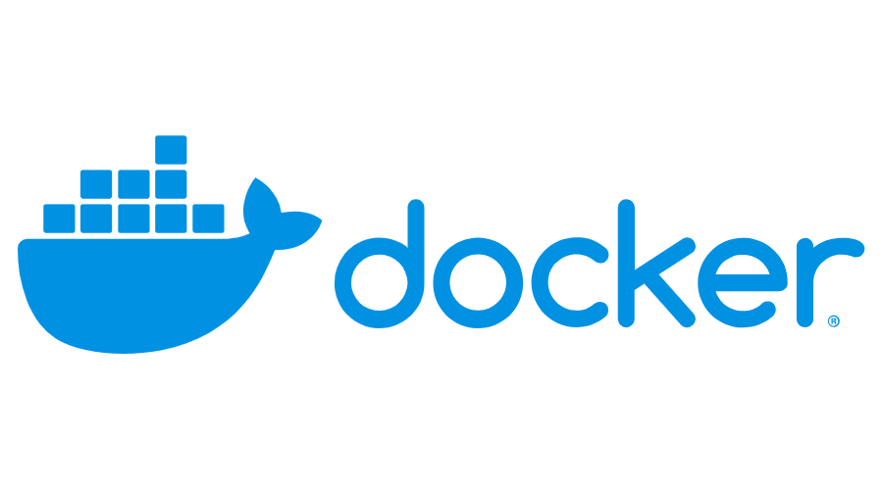
Domain – Storage and Volumes
Created by :Rajagopal K
670334

Slide 2
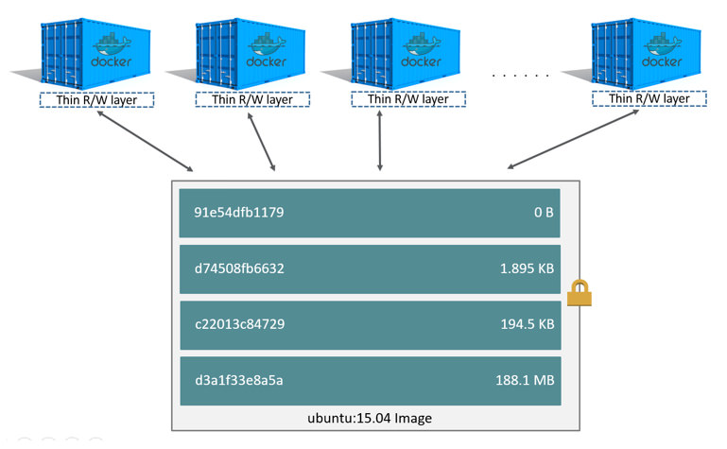
Docker Storage Drivers:
Ideally, very little data is written to a container’s writable layer, and you use Docker volumes to write data.
However, some workloads require you to be able to write to the container’s writable layer. This is where storage drivers come in.
Docker supports several different storage drivers, using a pluggable architecture.
The storage driver controls how images and containers are stored and managed on your Docker host.

Slide 3
Supported storage drivers :
For Docker CE, only some configurations are tested, and your operating system’s kernel may not support every storage driver. In general, the following configurations work on recent versions of the Linux distribution:
Linux distribution | Recommended storage drivers
Docker CE on Ubuntu | aufs, devicemapper, overlay2 (Ubuntu 14.04.4 or later, 16.04 or later), overlay, zfs, vfs
Docker CE on Debian | aufs, devicemapper, overlay2 (Debian Stretch), overlay, vfs
Docker CE on CentOS | devicemapper, vfs
Docker CE on Fedora | devicemapper, overlay2 (Fedora 26 or later, experimental), overlay(experimental), vfs

Slide 4
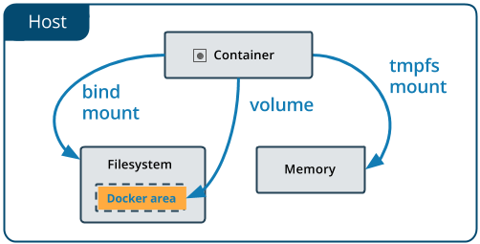
Volumes:
Volumes are the preferred mechanism for persisting data generated by and used by Docker containers. While bind mounts are dependent on the directory structure of the host machine, volumes are completely managed by Docker. Volumes have several advantages over bind mounts:
Volumes are easier to back up or migrate than bind mounts.
You can manage volumes using Docker CLI commands or the Docker API.
Volumes work on both Linux and Windows containers.
Volumes can be more safely shared among multiple containers.
Volume drivers let you store volumes on remote hosts or cloud providers, to encrypt the contents of volumes, or to add other functionality.
New volumes can have their content pre-populated by a container.

Slide 5
Create and manage volumes :
docker volume create my-vol
docker volume ls
docker volume inspect my-vol
[
{
"Driver": "local",
"Labels": {},
"Mountpoint": "/var/lib/docker/volumes/my-vol/_data",
"Name": "my-vol",
"Options": {},
"Scope": "local“
}
]
docker volume rm my-vol

Slide 6
Start a container with a volume :
Using –v flag
docker run -d --name devtest -v myvol2:/app nginx:latest
Using –mount flag
docker run -d --name devtest --mount source=myvol2,target=/app nginx:latest
Start a service with volumes :
The docker service create command does not support the -v or --volume flag. When mounting a volume into a service’s containers, you must use the --mount flag.
docker service create -d --replicas=4 --name devtest-service --mount=myvol2,target=/app nginx:latest

Slide 7
Use a read-only volume :
Using –v flag
docker run -d --name=nginxtest -v nginx-vol:/usr/share/nginx/html:ro nginx:latest
Using –mount flag
docker run -d --name=nginxtest –mount source=nginx-vol,destination=/usr/share/nginx/html,readonly nginx:latest
Remove all volumes :
docker volume prune

Slide 8
REFERENCE LINKS
State which graph driver should be used on which OS
Demonstrate how to configure devicemapper
Compare object storage to block storage and explain which one is preferable when available
Summarize how an application is composed of layers and where those layers reside on the filesystem
Describe how volumes are used with Docker for persistent storage
Identify the steps you would take to clean up unused images on a filesystem also on DTR
Demonstrate how storage can be used across cluster nodes

Slide 9
THANK YOU

